Slide 1

CET3014B Object Oriented Concepts with C++ and Java

Slide 2
CET3014B Object Oriented Concepts with C++ and Java
Course Objectives:
Understand basic concepts of Object Oriented Programming
Learn Inheritance, Polymorphism and Exception Handling features of Object Oriented Programming
Study concepts of Standard Template Library

Slide 3
File Handling and Exception Handling

Slide 4
File Handling
Streams and Files
Stream classes & Stream Errors
File Pointers
File I/O with Member functions
Formatted I/O and I/O manipulators
Error handling during file operations
Overloading of extraction and insertion operators

Slide 5
Streams
Stream is sequence of bytes
Name given to a flow of data
Represented by an object of a particular class
Used to represent different kinds of data flow
Interface between I/O and Program
Two streams
Input stream
Output stream
Input Stream
Extraction from Input Stream
Input Device
Program
Output Stream
Insertion to output Stream
Output Device
Input stream can come from keyboard or any other storage device.
Output stream can go to screen or any other storage device

Slide 6
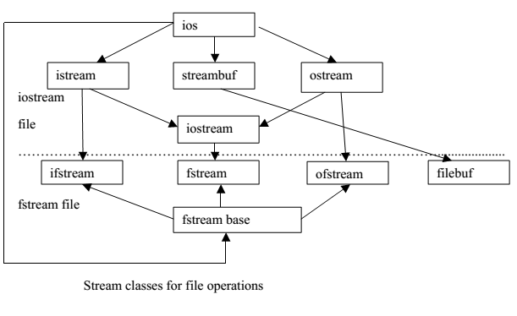
Stream Classes

Slide 7
Stream Classes for I/O
Class name | Contents
ios (general input/output stream class) | Basic facilities that are used by all other input-output classes
istream (input stream) | Inherits properties of ios Has functions like get(), getline(), read() Contains operator >>
ostream (output stream) | Inherits properties of ios put(), write() functions Contains operator <<
iostream (input/ output stream) | Inherits properties of istream and ostream through multiple inheritance and thus contains all input and output functions

Slide 8
File
A file is a collection of related data stored in a particular area on the disk .The data is stored in disk using the concept of file .
The information / data stored under a specific name on a storage device, is called a file.
Types of File
1:ASCII Text File
-Data Stored in ASCII character
-Processed Sequentially in forward direction
-Eof character is present at the end of file
2:Binary File
-Data Stored in binary format
-Processed randomly
Why to use File Handling
-For permanent storage.
-The transfer of input - data or output - data from one computer to another can be easily done by using files.

Slide 9
Stream Classes for File
Class name | Contents
fstream (general file input/output stream class) | This is used to both read and write data from/to files Provides support for simultaneous input and output operations. Contains open() with default input mode. Inherits all the function from isteram and ostream classes through iostream
ifstream (file input stream) | This is used to read data from files Provides input operations. Contains open() with default input mode. Inherits the functions get(), getline(), read(), seekg() and tellg() function from istream.
ofstream (file output stream) | This is used to create a file and write data on files Provides output operations. Contains open() with default output mode. Inherits put(), seekp(), tellp() and write() function from ostream

Slide 10
Steps in File Handling
Following steps are followed in File I/O process: 1. Include the header file fstream in the program. 2. Declare file stream object. 3. Open the file with the file stream object. 4. Use the file stream object with >>, <<, or other input/output functions. 5. Close the files.

Slide 11
Functions used in File Handling
Function | Operation
open( ) | To open/create a file
close( ) | To close an existing file
get( ) | Read a single character from a file
put( ) | write a single character in file.
read( ) | Read data from file
write( ) | Write data into file.

Slide 12
File open()
Two ways to open file
By Using Constructor
By Using open() function
By using Constructor:
The file is open while creating object of stream classes.
Syntax:
file_stream_class stream_object(“filename”);
#include<fstream>
using namespace std;
int main()
{
ifstream fin("abc.txt");
ofstream fout("xyz.txt");
}
abc.txt open in input mode
abc.txt
Hi,
Welcome to MITWPU
xyz.txt open in output mode
xyz.txt
Hello
Welcome to SCET

Slide 13
File open()
Two ways to open file
By Using Constructor
By Using open() function
2) By using open() function:
The function open() can be used to open multiple files that use the same stream object
Syntax:
file-stream-class stream-object;
stream-object . open (“filename”, mode);
#include<fstream>
int main()
{
ifstream fin;
fin.open("abc.txt");
ofstream fout;
fout.open("xyz.txt");
fstream file;
file.open("pqr.txt");
}
abc.txt open in input mode
abc.txt
Hi,
Welcome to MITWPU
xyz.txt open in output mode
xyz.txt
Hello
Welcome to CSE dept
pqr.txt
pqr.txt open in input & output mode
Object Oriented Concepts with C++ and Java

Slide 14
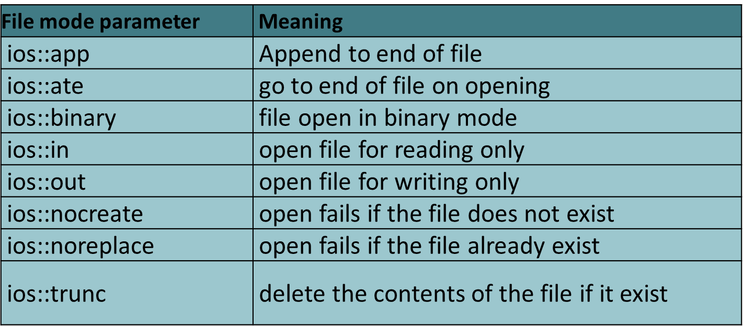
File Opening Modes
#include<fstream>
int main()
{
ifstream fin;
fin.open("abc.txt",ios::in);
ofstream fout;
fout.open("xyz.txt",ios::out);
fstream file;
file.open("pqr.txt",ios::out|ios::app);
}
abc.txt open in input mode
abc.txt
Hi,
Welcome to MITWPU
xyz.txt open in output mode
xyz.txt
pqr.txt open in output & append mode
Hello
Welcome to SCET
pqr.txt
Object Oriented Concepts with C++ and Java

Slide 15
File close()
The function close() is used to close file. File must be closed after completing all operations on it
Syntax: stream_object.close();
#include<fstream>
int main()
{
ifstream fin;
fin.open("abc.txt",ios::in);
ofstream fout;
fout.open("xyz.txt",ios::out);
fstream file;
file.open("pqr.txt",ios::out|ios::app);
fin.close();
fout.close();
file.close();
}
abc.txt open in input mode
abc.txt
Hi,
Welcome to MITWPU
xyz.txt open in output mode
xyz.txt
Hello
Welcome to SCET
test .txt open in output & append mode
test.txt
Object Oriented Concepts with C++ and Java

Slide 16
bool is_open( )
This function returns true if the file is opened and associated with this stream. Otherwise, it returns false:
Syntax: fin.is_open();
#include<fstream>
using namespace std;
int main()
{
ifstream fin;
fin.open("abc.txt");
if (!fin.is_open())
cout<<"Cannot open file!"<<endl;
fin.close();
}
return 1 if file is open else return 0
abc.txt
Hi, Welcome

Slide 17
Functions used in Input/output Operations
Function | Operation | Parameter
get( ) | Read a single character from a file | ch=cin.get(); OR cin.get(ch); ch=fin.get(); OR fin.get(ch)
getline() | Read a line or text that ends with a newline character from a file | getline(cin, line) getline(cin, line,delimchar) OR getline(fin, line) getline(fin, line, delimchar)
put( ) | write a single character in file. | cout.put(ch) OR fout.put(ch)
read( ) | Read data from file | file . read ((char *)&V , sizeof (V));
write( ) | Write data into file | file . write ((char *)&V , sizeof (V));
>> operator (Extraction) | Read data from file | cin>>ch OR fin>>ch
<< operator(Insertion) | Write data into file | cout<<ch OR fout<<ch

Slide 18
Reading and Writing into file using get() and put()
get() function reads single character from file and put() function writes single character to file
Syntax: ch=fin.get(); OR fin.get(ch)
fout.put(ch)
#include<fstream>
using namespace std;
int main() {
ifstream fin;
fin.open("abc.txt");
ofstream fout;
fout.open("xyz.txt");
char ch;
fin.get(ch);
fout .put(ch);
fin.close( );
fout.close( );
return 0;
}
abc.txt open in input mode
abc.txt
H
xyz.txt open in output mode
xyz.txt
H

Slide 19
getline()
getline() function reads a line or text that ends with a newline character from a file
Syntax: getline (object, char* str, char delim = ‘\n’);
getline(fin, line)
getline(fin, line, delimchar)
#include<fstream>
using namespace std;
int main() {
string str;
ifstream fin;
fin.open("test.txt");
getline(fin,str);
cout<<"Data of Fileis"<<endl;
cout<<str;
fin.close();
return 0;
}
test.txt
Hi, Welcome to MITWPU
Reads a line from file
Output Screen
Data of file is
Hi, Welcome to MITWPU

Slide 20
Reading and Writing into file using >> & << operator
Extraction >> operator reads data from file and Insertion << operator writes data to file
Syntax: fin>>ch
fout<<ch
#include<fstream>
using namespace std;
int main() {
ifstream fin;
fin.open("abc.txt");
ofstream fout;
fout.open("xyz.txt");
char ch[30];
fin>>ch;
fout << ch;
fin.close( );
fout.close( );
return 0;
}
abc.txt
Hi, Welcome
Reads a data from file abc.txt
xyz.txt
Writes a data to file xyz.txt
Hi, Welcome

Slide 21
read() & write()
class Student
{
int rollno;
string name;
public:
void getdata()
{
cout<<"enter roll no & name of student";
cin>>rollno>>name;
}
void putdata()
{
cout<<"Roll"<<rollno;
cout<<"Name";
cout<<name;
}
};
int main()
{
Student S1,S2;
S1.getdata();
fstream file;
file.open(“test.dat",ios::binary);
file.write((char *)&S1,sizeof(S1));
file.read((char *)&S2,sizeof(S2));
S2.putdata() ;
file.close();
return 0;
}
read() function reads a data from file and write() function writes a data to file.
Syntax: file . read ((char *)&V , sizeof (V));
file . write ((char *)&V , sizeof (V));
test.txt
11
Abc
Output Screen
Roll 11
Name Abc

Slide 22
#include <iostream>
#include <fstream>
using namespace std;
class student {
private: char name[30]; int age; public: void getData(void) {
cout<<"Enter name:"; cin.getline(name,30); cout<<"Enter age:"; cin>>age; }
void showData(void) { cout<<"Name:"<<name<<",Age:"<<age<<endl; } };
int main() {
student s;
ofstream file; //open file in write mode
file.open("aaa.txt",ios::out);
if(!file) { cout<<"Error in creating file.."<<endl; return 0; } cout<<"\nFile created successfully."<<endl;
//write into file
s.getData(); //read from user file.write((char*)&s,sizeof(s)); //write into file
file.close(); //close the file
cout<<"\nFile saved and closed succesfully."<<endl; //re open file in input mode and read data
//open file1
ifstream file1; //again open file in read mode file1.open("aaa.txt",ios::in);
if(!file1){
cout<<"Error in opening file..";
return 0; }
//read data from file
file1.read((char*)&s,sizeof(s));
//display data on monitor s.showData();
//close the file file1.close();
return 0; }

Slide 23
File Pointers and Manipulation Functions
Each file have two associated pointers known as the file pointers.
One of them is called the Input Pointer (or get pointer)
The other is called the Output Pointer (or put pointer).
The input pointer is used for reading the contents of a given file location and the output pointer is used for writing to a given file location.
To move file pointer to desired position use these function to manage the file pointers.
seekg() = moves get pointer (input) to a specified location
seekp() = moves put pointer (output) to a specified location
tellg() = gives the current position of the get pointer
tellp() = gives the current position of the put pointer

Slide 24
File Manipulation functions
Function | Operation
seekg(0, ios :: beg) | go to start
seekg(0, ios :: cur) | stay at current position
seekg(0, ios :: end) | go to the end of file
seekg(m, ios :: beg) | move to m+1 byte in the file
seekg(m, ios :: cur) | go forward by m bytes from the current position
seekg(-m, ios :: cur) | go backward by m bytes from the current position
seekg(-m, ios :: end) | go backward by m bytes from the end

Slide 25
Program to set file pointer
fstream file;
file.open("test.txt");
if(!file.is_open())
{cout << " Cannot open file!"; }
file << "This is the first line “<<endl;
file << "This is the second line" <<endl;
file.seekg(ios::beg);
for (int i = 0; i != 5; ++i) { cout << (char)file.get() << endl; }
char next = file.get();
cout << "The next character is " << (char)next ;
cout<<endl;
file.seekg(ios::beg);
char* str = new char[50];
file.getline(str, 50);
cout << str << endl;
file.ignore();
cout << "Peek " << (char) file.peek() << endl;
cout << "Current position is " << file.tellg() << endl;
file.close();
}
open file test.txt for input and output
test.txt
This is the first line
This is the second line
Output Screen
reset position of the input
T
h
i
s
The next character is=i
This is the first line
Peek= h
Current position is= 24
reset position again
show the next character without extracting it from file
get current position

Slide 26
Exception Handling Topics
Exception Handling
Exception Handling Mechanism
Multiple Exceptions, re-throwing an exception
Exception and Inheritance.

Slide 27
Exception Handling
Exceptions
Indicate problems that occur during a program’s execution
Occur infrequently
Exception handling
Can resolve exceptions
Allow a program to continue executing or
Notify the user of the problem and
Terminate the program in a controlled manner
Makes programs robust and fault-tolerant
Remove error-handling code from the program execution’s “main line”

Slide 28
Exception Handling
Programmers can handle any exceptions they choose
All exceptions
All exceptions of a certain type
All exceptions of a group of related types
A standard mechanism for processing errors
Especially important when working on a project with a large team of programmers
C++ exception handling is much like Java’s
With exception handling, a program can continue executing (rather than terminating) after dealing with a problem.
When no exceptions occur, there is no performance penalty

Slide 29
Exception Handling – try and catch blocks
try
{
}
Program statements
requires monitor for exceptions
catch( type argument )
{
}
Program statements
handles for Exception

Slide 30
Example
try
{
}
int d = 0;
int a = 30 / d;
Arithmetic Exception
throws
catch(int e )
{
}
printf("Division by zero.");

Slide 31
try
{
}
Program statements
requires monitor for exceptions
catch( type1 argument )
{
}
catch( type2 argument )
{
}
Program statements
handles for Exception
Program statements
handles for Exception
catch( typen argument ){
}
Program statements
handles for Exception

Slide 32
Execution of try-catch
Case 1: A
statement throws
an exception
Case 2: No
statements throw
an exception
Exception
Handler
Control moves directly to exception handler
Statements to deal with exception are executed
Statement
following entire try-catch
statement

Slide 33
C++ Exception Handlers
Exception Handlers Form:
try {
-- code that is expected to raise an exception
}
catch (formal parameter) {
-- handler code
}
...
catch (formal parameter) {
-- handler code
}

Slide 34
Try-catch-throw Block
try: Keyword try followed by braces ({}) Should enclose
Statements that might cause exceptions
Statements that should be skipped in case of an exception
catch: Keyword catch
Immediately follow a try block
One or more catch handlers for each try block
Exception parameter enclosed in parentheses
Represents the type of exception to process
Executes if exception parameter type matches the exception thrown in the try block
throw: Keyword throw followed by an operand representing the type of exception
The throw operand can be of any type
If the throw operand is an object, it is called an exception object
The throw operand initializes the exception parameter in the matching catch handler, if one is found
try
{
Statement 1;
Statement 2;
throw x;
} catch(m)
{
Error handler routine
}

Slide 35
Flow of execution of try/catch blocks.
int main() {
int x = -1;
cout << "Before try block\n";
try {
cout << "Inside try block \n";
if (x < 0) {
throw x;
cout << "After throw (Never executed) \n";
}
}
catch (int x ) {
cout << "Exception Caught \n";
}
cout << "After catch (Will be executed) \n";
return 0;
}
O/P:
Before try block
Inside try block
Exception Caught
After catch (Will be executed)

Slide 36
Example: Exception divide by zero
#include<iostream>
using namespace std;
int main() {
int opr1,opr2; float res;
cout << "Enter operand 1 and 2:-“; cin>>opr1>>opr2;
try {
if (opr2 == 0) {
throw (opr2);
}
else {
res=(float)opr1/opr2; cout << "Result is:" << res;
}
}
catch (int i) {
cout << "Answer is infinite because opr2 is:" << i;
}
return 0;
}

Slide 37
Ex: If exception is thrown and not caught then program terminates abnormally.
#include <iostream>
using namespace std;
int main()
{
try{
throw 'a';
}
catch(int x){
cout << "Caught ";
}
return 0;
}

Slide 38
Catching All Exceptions:-
If we use an ellipsis (...) as the parameter of catch, that handler will catch any exception doesn’t matter what the type of the throw exception is.
try {
// code here}
catch (int param)
{ cout << "int exception"; }
catch (char param)
{ cout << "char exception"; }
catch (...)
{ cout << "default exception"; }

Slide 39
Exception Specification
Also called throw lists
Comma-separated list of exception classes in parentheses
Indicates someFunction can throw types ExceptionA, ExceptionB and ExceptionC
A function can throw only exceptions of types in its specification (or derived types)
If a function throws a non-specification exception, function unexpected is called This normally terminates the program
Absence of exception specification indicates that the function can throw any exception
An empty exception specification, throw(), indicates the function cannot throw any exceptions
int someFunction( double value ) throw ( ExceptionA, ExceptionB, ExceptionC ) { ... }

Slide 40
Exception & Inheritance
New exception classes can be defined to inherit from existing exception classes
A catch handler for a particular exception class can also catch exceptions of classes derived from that class
Enables catching related errors with a concise notation

Slide 41
Standard Library Exception Hierarchy
Base-class exception
Contains virtual function what for storing error messages
Exception classes derived from exception
bad_alloc – thrown by new
bad_cast – thrown by dynamic_cast
bad_typeid – thrown by typeid
bad_exception – thrown by unexpected
Instead of terminating the program or calling the function specified by set_unexpected Used only if bad_exception is in the function’s throw list

Slide 42
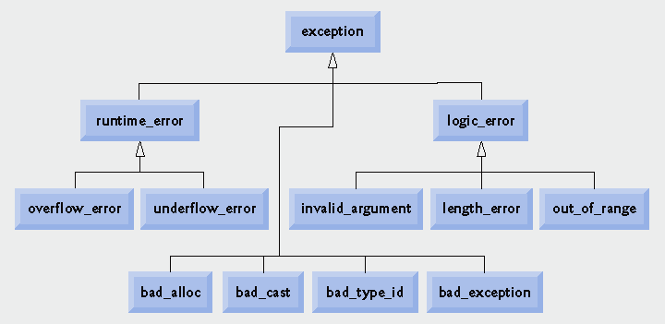
Standard Library Exceptions

Slide 43
Summary
Course Outcomes:
After completion of this course, students will be able to:
Apply the basic concepts of Object Oriented Programming in application development
Design and develop real world applications using inheritance, Polymorphism and Exception Handling features
Explore and use Standard Template Library to simplify programming

Slide 44
Reference
Books:
Herbert Schildt, ‘C++ The Complete Reference’, Fourth Edition, McGraw Hill Professional, 2011, ISBN-13: 978-0072226805
Robert Lafore, ‘Object-Oriented Programming in C++’, Fourth Edition, Sams Publishing, ISBN: 0672323087, ISBN-13: 978-8131722824
Bjarne Stroustrup, ‘The C++ Programming language’, Third Edition, Pearson Education. ISBN: 9788131705216
K. R. Venugopal, Rajkumar Buyya, T. Ravishankar, ‘Mastering C++’, Tata McGraw-Hill, ISBN 13: 9780074634547
Weblinks:
1. https://nptel.ac.in/courses/106105151/
2. http://nptel.ac.in/syllabus/106106110/
3. http://ocw.mit.edu
MOOCs:
https://onlinecourses.nptel.ac.in/noc18_cs32

Slide 45
Question Bank
Theory Questions
MCQ

Slide 46
Practice Assignments
Program to read from text file and display it
Program to count number of words
Program to copy contents of file to another file
Program to replace word in a file
Write a menu driven program that will create a data file containing the list of telephone numbers in the following form
John 23456
Ahmed 9876
Use a class object to store each set of data, access the file created and implement the following tasks
I. Determine the telephone number of specified person
II. Determine the name if telephone number is known
III. Update the telephone number, whenever there is a change.

Slide 47
Thank You!!

